Slide 1
Study of Diabetes in MES13 cells RNA-seq Analysis with R Package DEGseq
Davit Sargsyan
April 2018

Slide 2
RNA-seq Sample Details
FastQ files were processed by Renyi (mes13_featurecounts_Dec2017_david.csv) in December 2017
Table contains 24,421 genes found in 3 samples: LG, HG and TIIA
Removed genes with low counts (< 21 across all 7 samples). 13,954 genes left.
Applied DEGseq (“Identify Differentially Expressed Genes from RNA-seq data”, Likun Wang et al)
Notes:
Renyi’s workflow?

Slide 4
Normalized log differences
Gene | HG-LG | TIIA-HG
Hsd3b2 | 3.659 | -2.117
5330417C22Rik | 2.681 | -2.460
Mab21l3 | 1.514 | -1.198
Lrrc15 | 1.337 | -1.001
Pkd1l3 | 1.161 | -0.770
Inpp5d | 0.994 | -0.560
Evpl | 0.871 | -0.524
Tdrd5 | 0.801 | -0.894
Kcnj2 | 0.801 | -0.816
Hic1 | 0.782 | -0.683
Bok | -0.563 | 0.656
Rnf144a | -0.568 | 0.535
Itgb6 | -0.663 | -1.626
Tgfb1i1 | -0.712 | 0.817
Acta2 | -0.939 | 0.508
Col7a1 | -1.066 | 0.869
Trabd2b | -1.122 | 0.790
Upk3b | -1.133 | 1.409
Atp2a1 | -2.041 | 1.999
Ankrd61 | -2.626 | 2.114
Il23r | -2.848 | 3.906
31-10
10
366-10
25-10
10
206-10

Slide 6
263
56
763
207
46
556

Slide 7
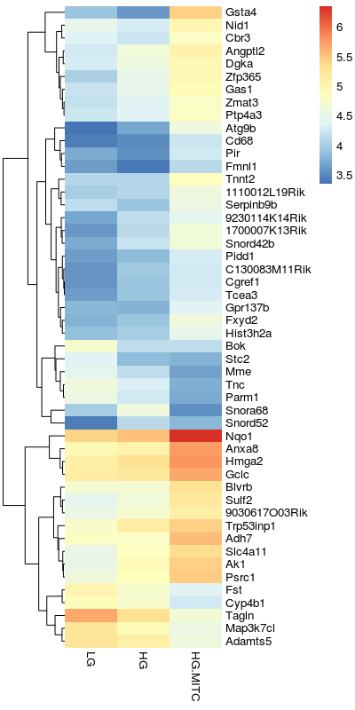
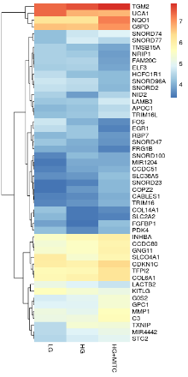
A
B
Log₂(RPKM)

Slide 8
Methyl-seq Sample Details
Applied DSS package
Notes:
Renyi’s workflow?

